Slide 1




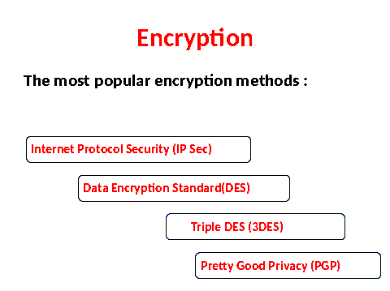
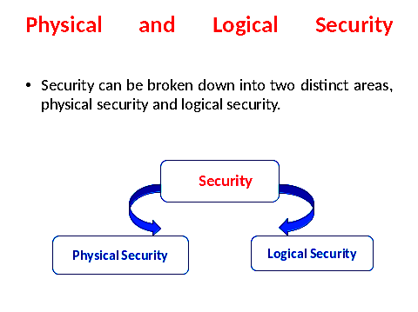

SECURING THE NETWORK
Threats to Security
Deliberate data damage
Industrial espionage
Physical equipment theft
Proxy Server
A proxy server acts as an intermediary between a user on the internal network and a service on the external network.
There are a couple of reasons to implement a proxy server.
To perform NAT function
To allow Internet access to be
controlled
Two Examples of
Network Security Measures
Security
Responsibilities of a
Network Adminstrative
Ensure that a security policy is in place
Ensure that the security policy is enforced
Ensure that any infractions of the security policy are dealt with
Ensure that the security situation is continually
evaluated, revised and updated
Blocking Port
Numbers
Encryption
How Security AFFECTS a Network
Implementing security measures has an effect on the network.
The effect of the security depends on which security measures are implemented and the habits of the network users.
Data Encryption Standard (DES)
DES was developed by IBM in the mid 1970s, and become a standard in 1977.
It encrypts an decrypts data in 64- bit chunks, using a 64-bit key.
Although the key is 64 bits, the actual encryption key used by DES is 56-bit key.
This is because 1 bit in every byte is reserved for parity, which leaves 56 bits.
3DES
It is often referred to as “triple DES”, is an improvement on the DES encryption standard.
It is widely used, and much more stronger version and is able to provide more security of data than the traditional DES.
It performs the encryption the same way as regular DES, but it does it three times.
Regular DES uses 64-bit key encryption method, whereas 3DES uses three 64-bit keys, for an overall key length of 192 bits.
Like DES one of the bit in each byte is reserved for parity, therefore, the actual key is 168 bits.
FireWalls
A firewall is a system or a group of systems that controls the flow of traffic between the two networks.
Its most common use is to protect a private network from a public network such as the internet.
How it manages the flow and what it does with certain types of traffic depends on its configuration.
Names: Annie, Zakir, Fareed Instructor: Asima Nisar

